Slide 1


Unit 2
HHFA communication products
Notes:
Welcome to Unit 2 of Module 5.
In this unit, we will look at different types of HHFA communication products.

Slide 2
By the end of this unit, you will:
describe the process of developing an HHFA final report
list key sections of an HHFA final report
provide examples of HHFA communication products, their target audiences and key contents
Notes:
By the end of this unit, you will:
describe the process of developing an HHFA final report;
list key sections of an HHFA final report; and
provide examples of HHFA communication products, their target audiences and key contents.

Slide 3
HHFA final report
Data review
Conclusions
Data
interpretation
cycle
Priorities
Further data analysis
Use of contextual information
Recommendations
Main HHFA findings, with explanations
Communication
Data use
Consultation with experts
Data triangulation
Improve health services
Notes:
In Module 4 we saw that the data interpretation cycle should result in identifying the main HHFA findings, along with their explanations.
This will lead to the HHFA:
conclusions;
the identification of priorities; and
the resulting recommendations.
This information must then be communicated to decision makers and other stakeholders that can use the data to improve health services.

Slide 4

HHFA final report
Conclusions
Interpretation workshop(s)
Prioritization based on:
Priorities
significance for service delivery system
Recommendations
availability and feasibility of corrective measures
Notes:
The final HHFA conclusions, priorities and recommendations are usually defined in the context of one or more interpretation workshops.
The prioritization of the findings and conclusions should be based on:
their significance for the service delivery system; and on
the availability and feasibility of corrective measures.
The outcomes of the interpretation workshop(s) will then form the basis of the HHFA final report.

Slide 5
HHFA final report
The HHFA final report is the key HHFA communication product.
Notes:
The HHFA final report, also called the full report, or “main” report, is the key HHFA communication product.

Slide 6

HHFA final report
It is important to make all the HHFA findings available, and also to present them in user-friendly ways.
Notes:
As the HHFA is a comprehensive survey, the final report may be lengthy.
It is important to make all the HHFA findings available, and also to present them in user-friendly ways.

Slide 7
HHFA final report
key messages
detailed key messages per section
key tables / graphs
It is important to make all the HHFA findings available, and also to present them in user-friendly ways.
Notes:
To facilitate communication of the most important issues, a limited number of overall key messages should be defined for the report.
More detailed key messages are also defined for each section, for example, for specific programme or management sections.
Furthermore, the HHFA data analysis platform produces a very large number of outputs, too many to include in the survey report.
The core data analysis team should therefore select a subset of key tables and graphs to include in the main body of the report.

Slide 8
HHFA final report
key messages
detailed key messages per section
key tables/graphs
Data annex: full set of tables and graphs
It is important to make all the HHFA findings available, and also to present them in user-friendly ways.
Notes:
The full set of tables and graphs can be made available separately as a data annex or in a separate document.

Slide 9
HHFA final report: Structure
Front page
Executive summary
References
Foreword
Introduction
Data annex
Contents
Objectives
Other annexes
Abbreviations
Methods
Data curation
Findings
Conclusions
Recommendations
This structure can be adapted according to the country needs.
The reading materials for this unit provide further details on the content and purpose of each section.
Notes:
The HHFA final or “main” report has a recommended structure, which consists of a:
Front page;
Foreword;
Table of Contents; and
Abbreviations;
Executive summary;
Introduction;
Objectives;
Methods;
Findings;
Conclusions; and
Recommendations;
References;
Data annex;
Other annexes; and
Data curation details.
However, this structure can be adapted according to the country needs.
The reading materials for this unit provide further details on the content and purpose of each section.

Slide 10
HHFA final report: Report-writers
Production of a HHFA report requires a substantial time commitment
It is recommended that:
a report-writer is recruited to draft the final report
the lead writer may be supported by
co-writers
the number of writers is limited for consistency of style and language
Notes:
The production of a high-quality final HHFA report requires a substantial time commitment.
Therefore, it is recommended that a dedicated report-writer be recruited to draft the final report.
Co-writers may support this lead writer, but the number of writers should be limited to ensure consistency of the style and language of the report.

Slide 11
HHFA final report: Report-writers
Production of a HHFA report requires a substantial time commitment
The report-writer(s) should:
have a clear understanding of the HHFA objectives and reporting requirements
be familiar with the HHFA methodology and tools
HHFA Comprehensive guide Annex A3.7 provides a sample job description
for a report-writer.
Notes:
The report-writer(s) should have:
a clear understanding of the HHFA objectives and reporting requirements; and
should also be familiar with the HHFA methodology and tools.
The HHFA Comprehensive guide Annex A3.7 provides a sample job description for a report writer.

Slide 12
HHFA final report: Preparation
1
2
Report-writers prepare the draft final report
Draft report is submitted to the survey coordination group for approval
4
3
Final report requires formal approval from the ministry of health
Draft report is presented in a “validation workshop” for multiple stakeholders
Notes:
The preparation of the final report requires several stages.
The report-writers prepare the draft final report.
The draft report is then submitted to the survey coordination group for approval.
The draft report is sometimes also presented in a “validation workshop” for multiple stakeholders, to gather final inputs and to promote momentum for action based on the HHFA findings.
After approval by the survey coordination group, the final report requires formal approval from the ministry of health before publication and dissemination.

Slide 13
HHFA communication products and audiences
Product / method | Audience
Product / method | Audience
Full (main) report | MoH national and subnational staff; programme managers (MoH and partners); planners
Short report | Policy-makers and high-level managers (MoH and partners)
Subnational report | MoH provincial and district staff; programme managers (MoH and partners)
Programme-specific report | Programme staff at various health system levels
Policy brief | Policy-makers
Oral presentation | Participants in planning meetings, health sector reviews, and other events
Dashboards | Policy-makers; high-level managers; planners
Press release | Journalists; news media
Social media | General public; followers
Notes:
As we discussed in Unit 1, it is important for the HHFA to provide a variety of communication products, tailored to the needs of diverse audiences.
The HHFA communication products include:
the final full or main report, which is intended for the Ministry of Health national and subnational staff, programme managers, and planners;
a short report, which is intended for policy-makers and high-level managers;
subnational reports, such as provincial reports intended for Ministry of Health provincial and district staff, and programme managers;
programme-specific reports, intended for programme staff at various health system levels;
policy briefs, designed for policy-makers;
oral presentations, prepared for participants in planning meetings, health sector reviews and other events;
dashboards, for policy-makers, high-level managers and planners;
press releases, intended for journalists and the news media; and
social media, which is used to communicate with the general public.

Slide 14

Dissemination of HHFA findings
Timely dissemination of the HHFA findings is the final critical step to ensuring the success of the survey.
dissemination should start as soon as possible
long delays can reduce the relevance of the HHFA findings
Notes:
Timely dissemination of the HHFA findings to all the relevant target audiences is the final critical step to ensuring the success of the survey.
Dissemination should start as soon as possible after preparing the final report, as the findings will be useful only if data are received by the intended recipients within a reasonable timeframe.
Long delays can reduce the relevance of the HHFA findings, with the result that they may no longer be useful for decision-making.

Slide 15

Dissemination of HHFA findings
HHFA planning and implementation processes often generate expectation
for the results.
build upon this momentum
provide the HHFA results quickly
Notes:
Furthermore, the HHFA planning and implementation processes often generate much expectation for the results among a wide range of stakeholders.
It is important to build upon this momentum and to provide the HHFA results quickly in order to maintain user interest and buy-in.

Slide 16

Ways to disseminate HHFA findings
national/subnational workshops
presentations to key donors
policy briefs
presentations in reviews and planning meetings
web dissemination
reports/scientific articles
press releases/social media
Notes:
Various activities can be used to disseminate HHFA findings. These may include:
national and/or subnational workshops;
presentations to key donors and other stakeholders;
policy briefs to high-level Ministry of Health decision-makers;
presentations in annual health sector reviews and planning meetings;
web dissemination;
publication of reports and scientific articles; and
press releases and use of newspapers and social media.

Slide 17
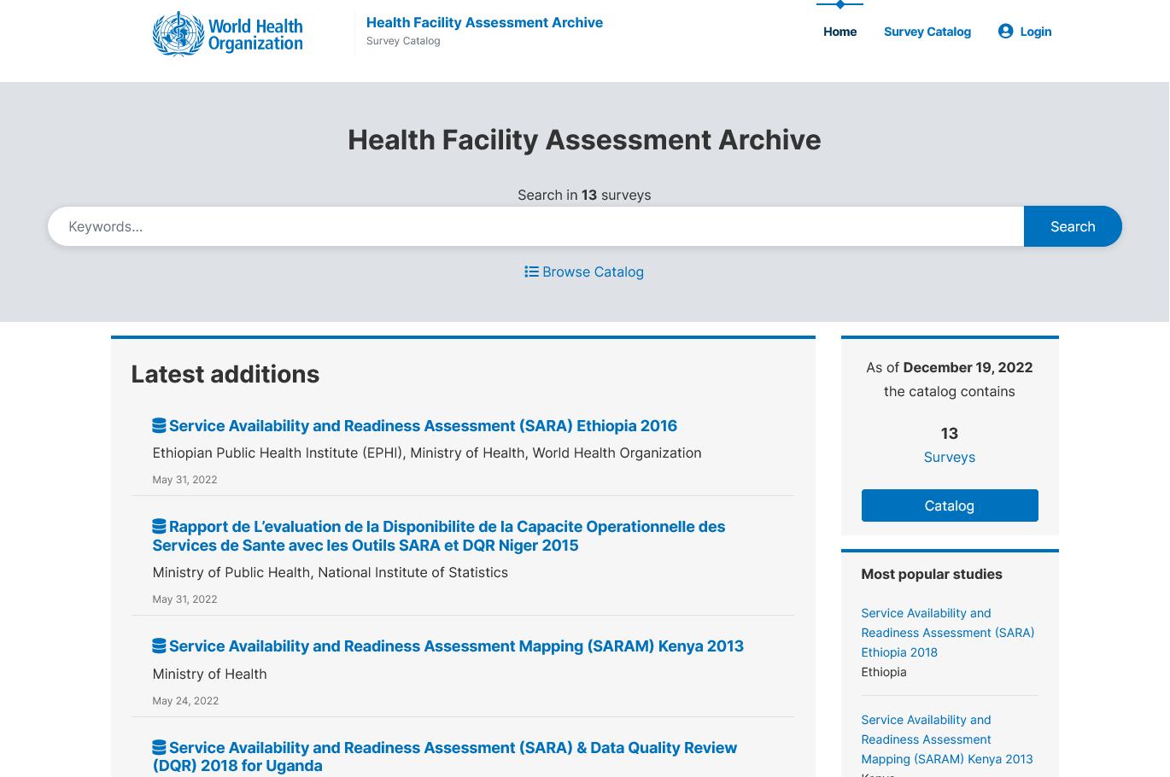
Ways to disseminate HHFA findings
The final report can be published in the WHO HHFA global archive:
https://data-archive.hhfa.online/index.php/home
Notes:
The HHFA final report can also be published in the WHO HHFA global archive.

Slide 18
You have now completed Unit 2.
Now try the end-of-module quiz.
Notes:
You have now completed Unit 2.
Now try the end-of-module quiz.

